Slide 1
SMART MULTI-HEURISTIC NAVIGATION SYSTEM
1
Supervised By,
Mridha Md Nafis Fuad
Lecturer
IIT, University of Dhaka
Jinnia Sultana Prova
BSSE1627

Slide 2
Project Overview
2
Objective: To design and implement an intelligent navigation system that dynamically generates optimal multi-modal routes by leveraging graph algorithms and user-centric preference modeling.
Key Features
Multi-Modal Route Integration Intelligently combines walking, rickshaw, bike, bus, and metro into a single seamless journey.
User-Driven Preference Balancing Allows personalized route optimization based on time, cost, and distance priorities.
Real-World Map & Traffic Simulation Uses OpenStreetMap data with simulated traffic to provide accurate and realistic navigation.
Seamless Transfer & Multiple Route Options Suggests optimal switching points and offers several balanced route alternatives.

Slide 3
Algorithms/Methods
3
A Search Algorithm*
Purpose: Finding the fastest path on the map.
Multi-Criteria Weighting Model
Transfer Point Detection
Purpose: Identifying optimal spots to switch transport modes.
Traffic Simulation Module
Purpose: Adding random yet realistic delays to routes.
Purpose: Balancing time, cost, and distance based on user choice.

Slide 4
Language & Tools
4
Load OpenStreetMap Data
Get User Input (Start, Destination, Preference)
Run A* Pathfinding (Multi-Modal)
Apply Traffic Simulation
Optimize Transfer Points
Generate Multiple Route Options
Display Personalized Routes
C++
OpenStreetMap Data
VS Code with GCC Compiler
File Handling For Map Data
Workflow

Slide 5
Implemented Features
5
Graph-Based Navigation System with single mode transport network
A Pathfinding* with heuristic-driven route calculation
Multi-Criteria Decision Model for personalized route ranking
Interactive CLI with map visualization and preference input
Cost & Time Modeling with mode-specific fare and speed logic

Slide 6
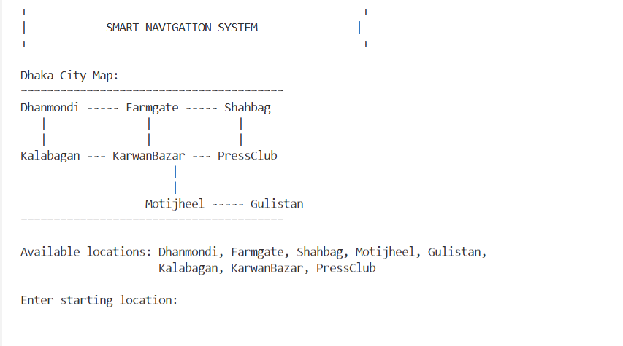
Progress So Far
6

Slide 7
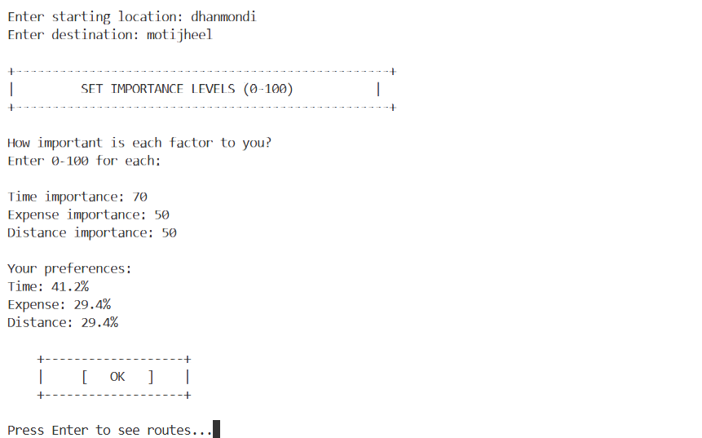
Progress So Far
7

Slide 8
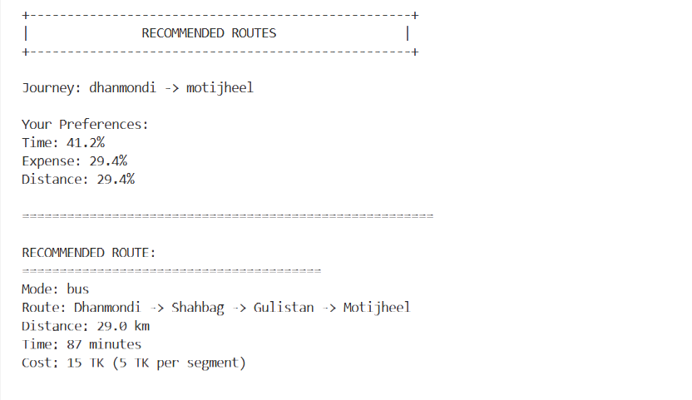
Progress So Far(Output)
8

Slide 9
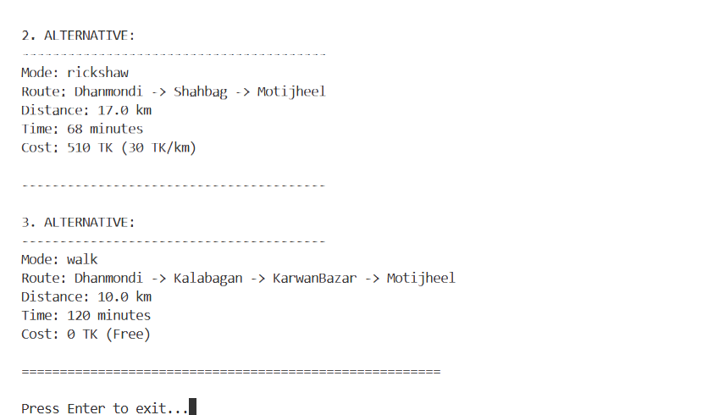
Progress So Far(Output)
9

Slide 10
Pending Development
10
Multimodal Route Synthesis – For combining multiple transport modes
Transfer Optimization – To detect best switching points
OpenStreetMap Integration – To import real map data
Traffic Simulation – Adding dynamic congestion modeling
Extended Modes – Adding bike and metro networks
Visualization & Scaling – GUI and large-network support

Slide 11
Thank you
11

